Slide 1
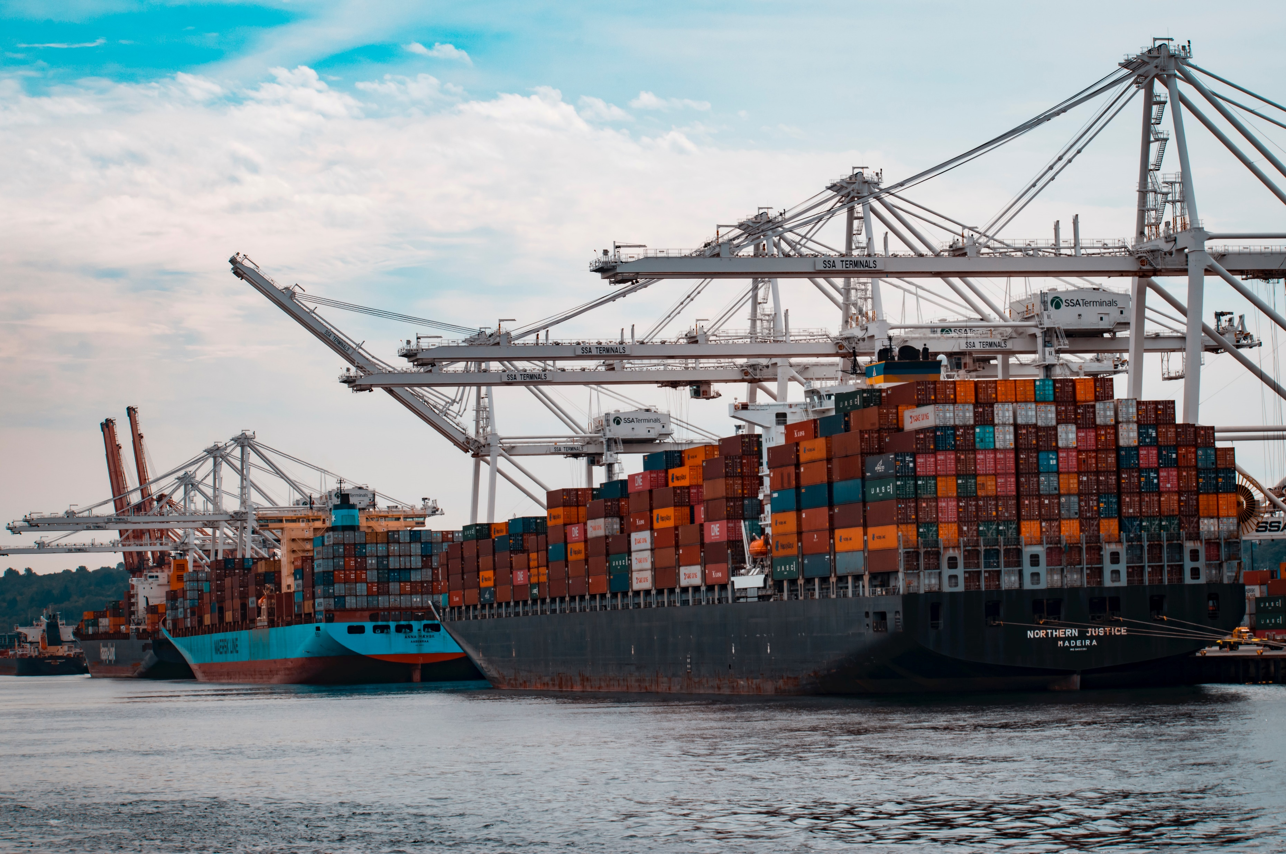
importers analysis
for BLUME CAPITAL

Slide 2
objectives
1
2
3
analyze US companies and their respective products who have been actively importing from various countries across the globe
create actionable insights out of the descriptive analysis of the data
create a predictive or machine learning model

Slide 3

investment management
value-oriented, research-driven investing
Blume Capital’s goal is to provide superior risk-adjusted returns for our clients while minimizing downside risk.

Slide 4
here’s what we found in 2021…

Slide 5
8,161
1.5M
importers
imports
20K
products
186
10.8M
countries
total TEU

Slide 6
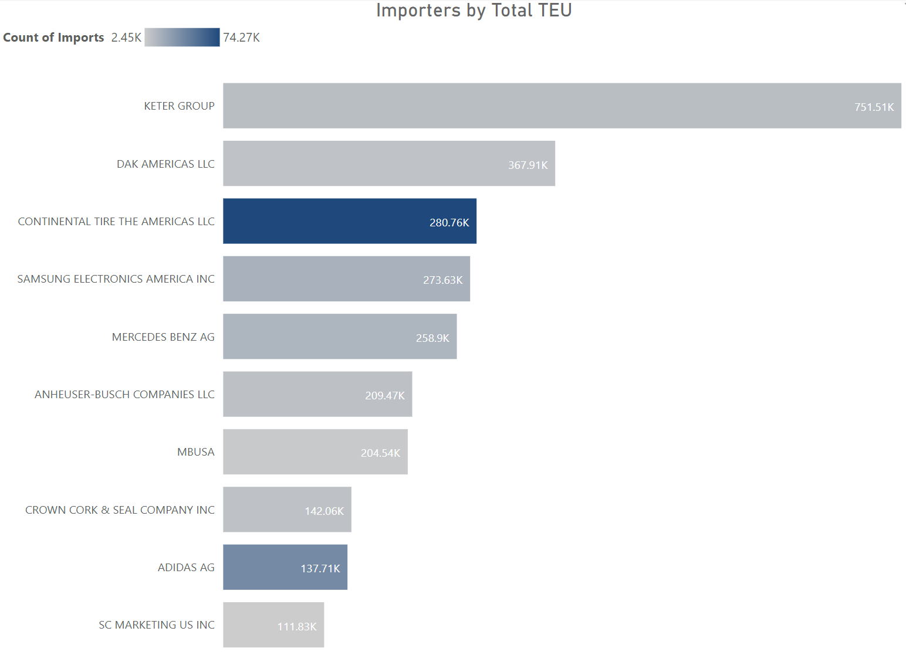
analysis of importers
Keter Group has imported bigger containers despite the lower frequency while Continental Tire The Americas LLC has the most frequent imports followed by Adidas AG.
Keter Group and Continental Tire The Americas LLC mainly import plastics / rubbers, DAK Americas LLC mainly imports chemicals and allied industries, and Adidas AG mainly imports textiles and footwear/headgear.

Slide 7
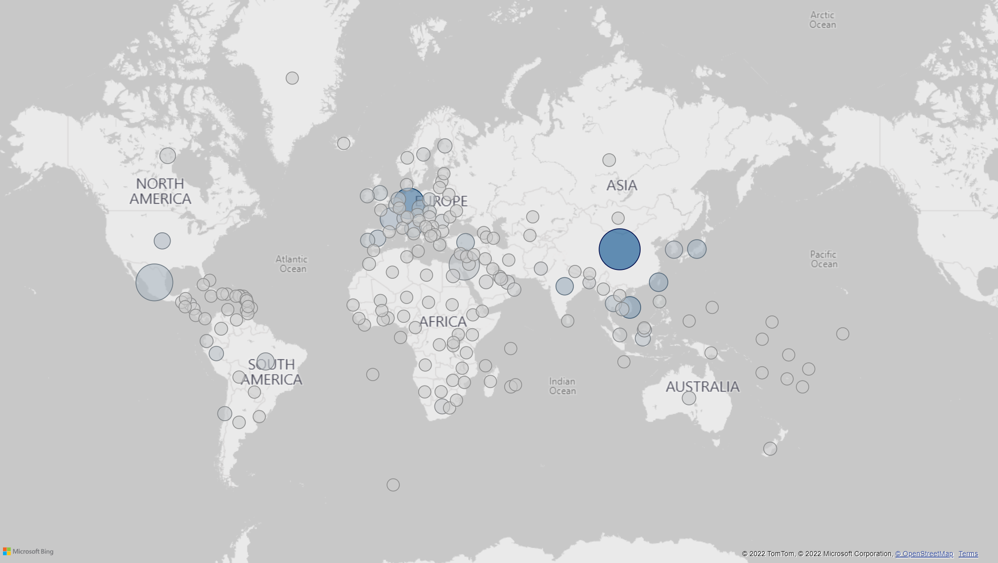
analysis of countries
US has the most imports with the largest total TEU from China from the following products:
Miscellaneous
Machinery / Electrical
Metals
Plastics / Rubbers
Textiles
..with the following importers:
Jo-Ann Stores Inc.
Electrolux AB
W S Badcock Corp
Anheuser-Busch Companies LLC
The Home Depot Inc.

Slide 8
analysis of countries
Germany follows, in terms of freq., with the following products:
Machinery / Electrical
Plastics / Rubbers
Transportation
Metals
Chemicals & Allied Industries
..with the following importers:
Mercedes Benz AG
Continental Tire the Americas LLC Scheffler Group Inc
Hella Kgaa Hueck & Co
ZF Chassis Systems Duncan LLC

Slide 9
analysis of countries
Mexico follows, in terms of TEU, with the following products:
Chemicals & Allied Industries
Machinery / Electrical
Transportation
Foodstuffs
Plastics / Rubbers
..with the following importers:
Samsung Electronics America Inc
DAK Americas LLC
Novapet, SA
CIA Integrada Textil De Pernambuco SA
Indorama Ventures Polymers

Slide 10
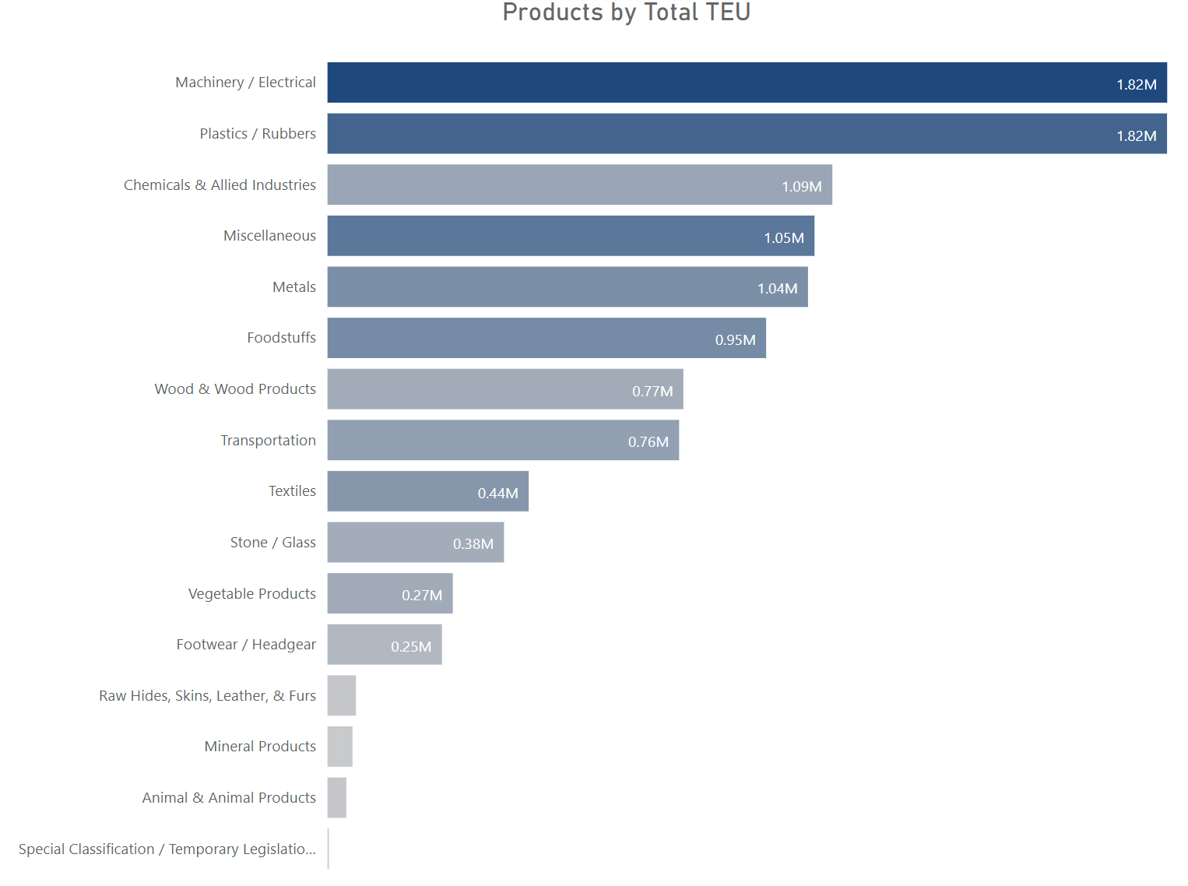
analysis of product/commodity
Most imported products (both in frequency and TEU) are machinery/ electrical and plastics/rubbers.
HSCode 47 (wood & wood products) tops the biggest import followed by HSCode 78 (metals), 65 (footwear/ feadgear), and HSCode 24 (foodstuffs).
HSCode 84 (nuclear reactors, boilers, machinery and mechanical appliances; parts thereof), HSCode 94 (furniture; bedding, mattresses, mattress supports…), and HSCode 40 (rubber and articles thereof) were most frequently imported products.

Slide 11
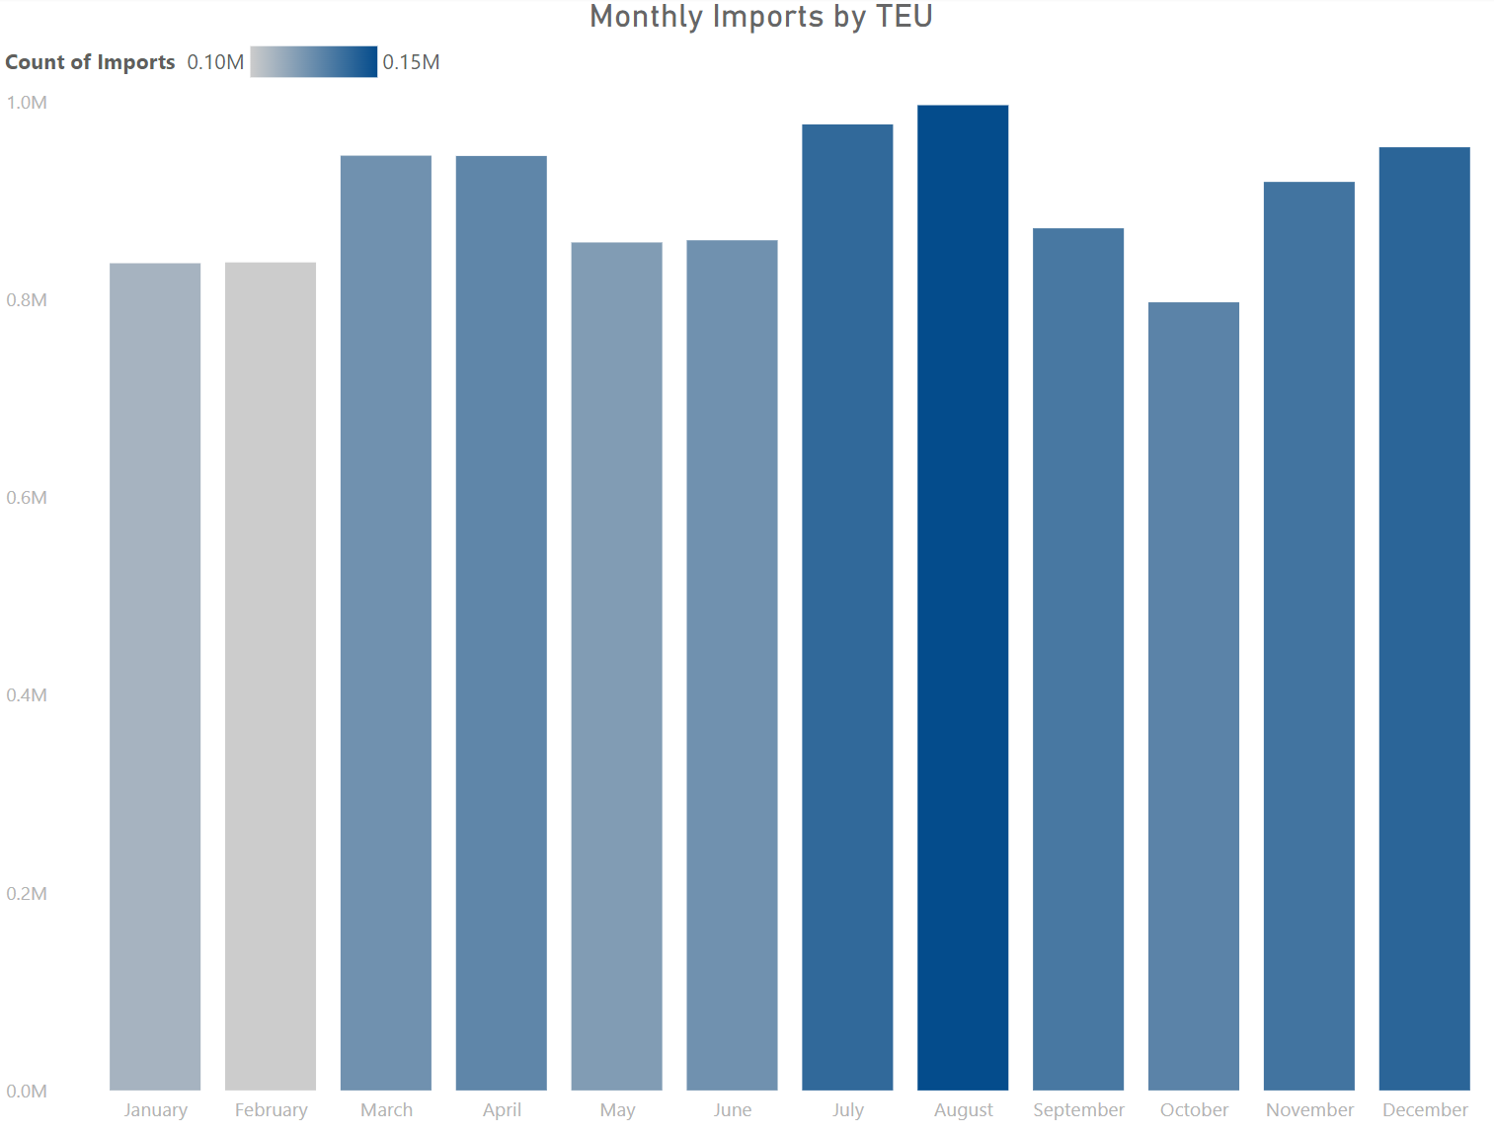
analysis of monthly imports
Biggest import was in August while the lowest was in October.
Highest number of imports are in August while lowest number of imports are in February.

Slide 12
investment grading
using k-means clustering
and the concepts of RFM analysis

Slide 13
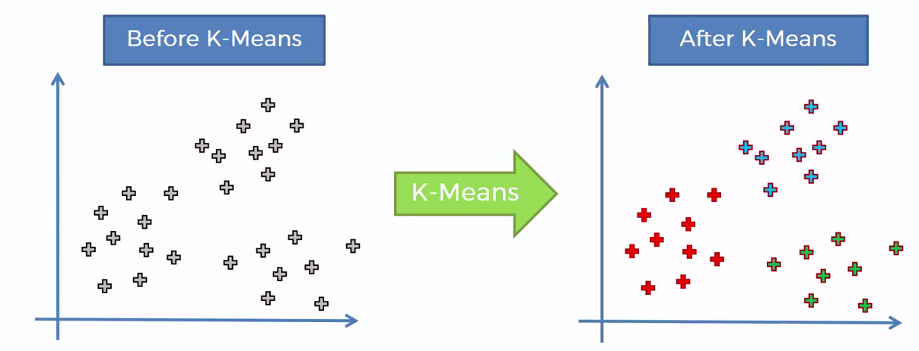
the model

Slide 14






Investment grade
A
recency
B
C
frequency
k-means
algorithm
investment grade
importer
D
TEU*
*TEU was used in lieu of the monetary characteristic

Slide 15
import forecast
using Facebook Prophet

Slide 16
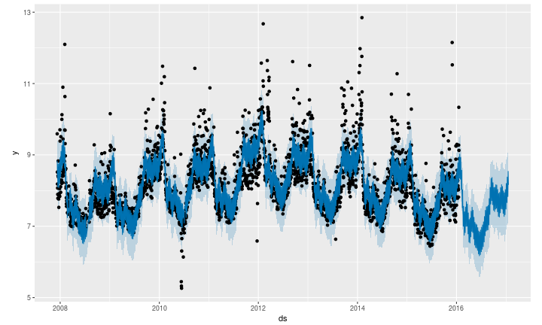
the model
At its core, it is an additive regression model with four main components:
A piecewise linear or logistic growth curve trend. Prophet automatically detects changes in trends by selecting changepoints from the data.
A yearly seasonal component modeled using Fourier series.
A weekly seasonal component using dummy variables.
A user-provided list of important holidays.

Slide 17
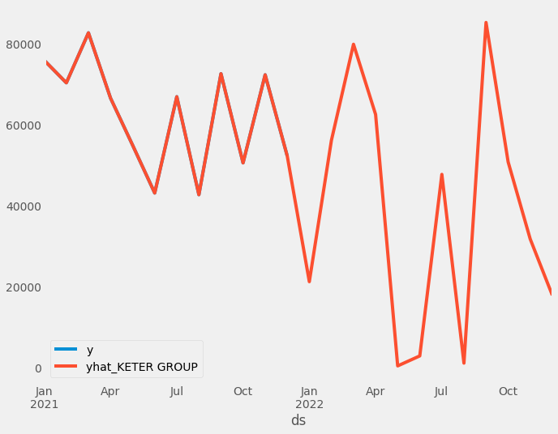
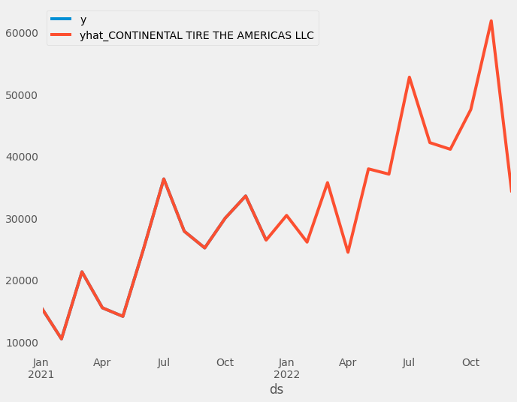
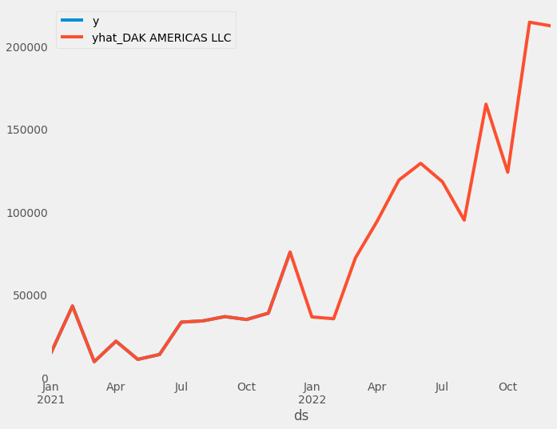
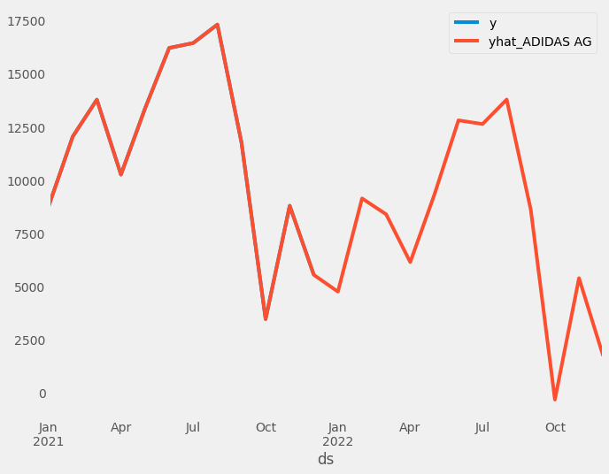
model performance
The model captured the pattern well on monthly imports of the four major importers during 2021 (the y line has been covered by the y_hat line).

